Slide 1
Global Refugee Migration and patterns
By Gresa, Sue and Mia

Slide 2
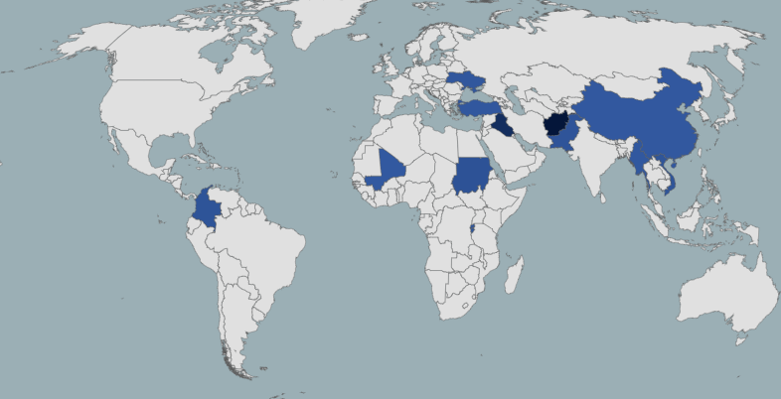
In this project we looked at the total numbers of refugees over the past few years. We wanted to find out which countries account for the highest numbers of refugees, which are the top refugee host countries and who the refugees are.
We used different data sets from unhcr.org, which we downloaded as a CSV, cleaned and merged in Pandas and then used D3 to create our visualizations.
The main questions we wanted to answer with our visualizations are:
What are the top origin countries for refugees?
What are the world’s top 10 refugee host countries?
Who are refugees and asylum seekers?

